Slide 1
System Calls Intro
07/09/2021

Slide 2
Terms
Fork
Exec
Copy of your process & part of RAM containing segments (for that pgm) goes into RAM
Runs the copy, overrides segments w/ what new resources are needed

Slide 3

Waits
Waiting for a program that has already started
Pgm waits for exit code of process to move forward

Slide 4
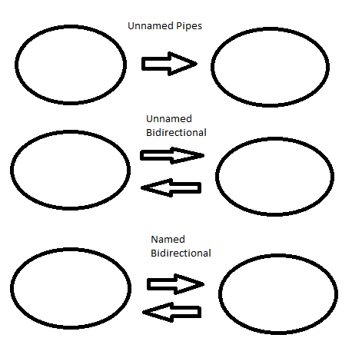
Interprocess Communications (IPC)

Slide 5
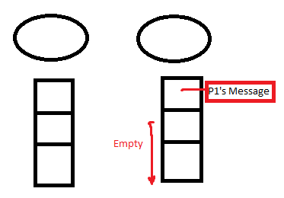
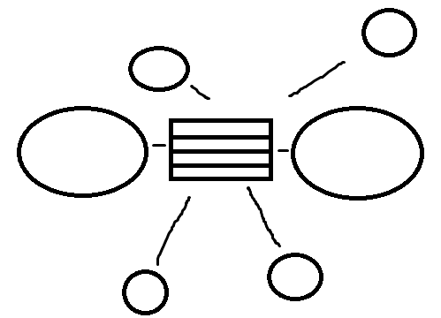
Individual Memory
FIFO
P1 (sender) creates message and sends into the bottom of P2’s queue
Shared Memory
Semaphore tells program which message should be read by who
Socket is the final IPC type but will note that later

